Slide 1
DIFFUSION STRATEGY OF GREEN TECHNOLOGY AND GREEN INDUSTRY IN AFRICA A Pilot Study of Renewable Energy Technology Market, and Energy Efficiency Adoption in Cassava and Maize Processing Industry in Kenya and Nigeria Funded by KEEI through UNIDO
René Kemp
UNU-MERIT
Policy Forum “Eco-innovation systems in developing countries”
Berlin, Jan 27, 2014

Slide 2
What the study is about
The market for modern renewable energy technologies (RET) in Sub-Saharan Africa, and
The uptake of energy efficiency (EE) measures in two agro-industrial sectors (cassava processing and maize milling) in two African countries (Nigeria and Kenya)

Slide 3
Background of the study
Renewable energy (RE) is spreading across (energy poor) Sub-Saharan Africa (SSA) but few studies have engaged in orginal data analysis on this.
Agro-industrial sectors constitute an important part of the economy in SSA, which makes them suited for an analysis of the prospects for green industrial development from an energy-using point of view.

Slide 4
Global Trends in Renewable Energy Investments (2012)
USD bn
Middle East and Africa
4
Rest of World
5
12
3
2
2
1
1
1
2004
2005
2006
2007
2008
2009
2010
2011
2012
Source: UNEP Global Trends in Renewable Energy Investments (2013).

Slide 5
Trends in Wind Installed Capacity
MW
Africa
1.021
Rest of World
919
281.409
237.116
2000
2001
2002
2003
2004
2005
2006
2007
2008
2009
2010
2011
2012
Source: Global Wind Statistics 2012 (GWEC)

Slide 6
Trends in Solar Installed Capacity
MW
Middle East and Africa
601
Rest of World
192
101.555
71
70.869
25
40.599
3
23.580
5.364
2000
2001
2002
2003
2004
2005
2006
2007
2008
2009
2010
2011
2012
Source: EPIA Global Market Outlook for Photovoltaics (2013).

Slide 7
Investments in Renewable Energy in Africa (2012)
USD bn
South Africa
5.70
Morocco
1.80
Kenya
1.10
Ethiopia
0.40
Note: omits countries with less than USD 0.1 bn investment.
Source: UNEP Global Trends in Renewable Energy Investments (2013).

Slide 8
Key research questions
What are the trends in renewable energy technology deployment and investment across various world regions, and how does investment in SSA compare with these global trends?
What are the product offerings and market prospects for RET (solar, wind, biomass, hydro) in Nigeria and Kenya?
What factors shape the diffusion of RET in Nigeria and Kenya?
What are the factors behind the choice and adoption of EE and RETs in agro-industrial sectors? What factors are preventing companies from investing more in EE and RET?
Is there a need for technical cooperation in RET and EE? If so, what form should this take?

Slide 9
The research approach
The research questions are assessed through two specially designed questionnaires, interviews with companies and experts and desk research
The project draws on the literature on diffusion and adoption of new technologies, the literature on innovation systems and the literature about global value chains.
Local and global aspects of value chains and innovation are being brought into the analysis, helping us to understand the indigenous and foreign sources of knowledge and technology, the need for financial assistance, technology transfer and technical cooperation.

Slide 10
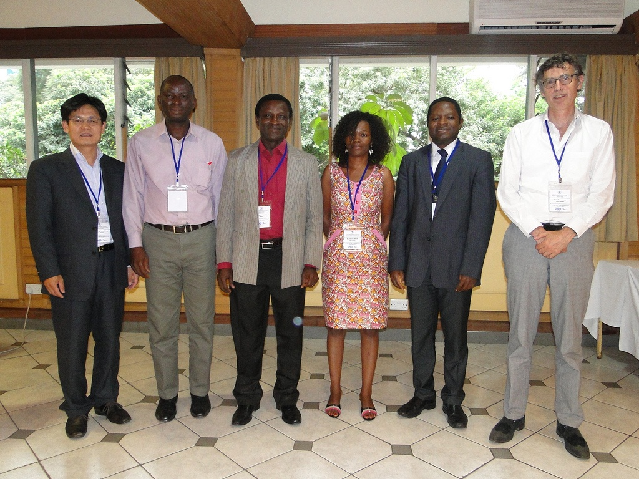
The research team
The research teams involves development specialists, innovation researchers and policy experts from Africa and Europe and is led by UNU-MERIT

Slide 11
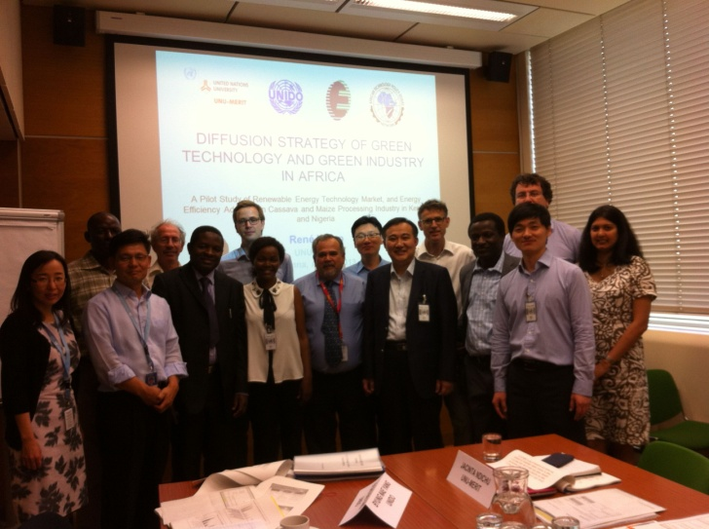
Time line
Sept 2012
Dec 2012
Jan 2013
Febr 2013
May – June 2013
June 2013
Aug 2013
Sept 2013
Nov 2013
End of Jan 2014
Start of the project
Workshop in Brussels
Report about analytical framework
2nd workshop in Brussel
Field-work
Policy makers workshop in Nairobi
1st draft report
2nd draft report
Vienna workshop at UNIDO
Final version of report

Slide 12
Key findings
The RET sectors are young: Most of the solar technology suppliers and almost all bioenergy and wind turbine companies which were examined in Kenya have been established after 2000.
Solar and biomass are the biggest RET markets with solar PV being based on foreign technology and biomass mostly based on domestic T and knowhow
The majority of the suppliers are not experiencing growth (82% in Nigeria and 71% in Kenya) but they are very positive about futures sales (64% and 56% are expecting signficant growth)
We did not observe energy leapfrogging and do not consider this a realistic option for SSA
There are many constraints to diffusion (a “web of constraints”)

Slide 13
Barriers
Lack of technical knowledge and financial sourcing come out as important barriers
RET suppliers also state that there is a strong need to improve the business climate in Kenya which affects availability of financial sources, especially from international financial institutions
To deal with these obstacles, RET suppliers offer specific services to reduce shortcomings. The reason for bundling the technology supply with advice on finance or provision of financing solutions is to overcome financing challenges and mobilize financial resources.
High import tariffs on RET components were mentioned as a barrier to adoption by 15% of the RET suppliers

Slide 14
Origin of suppliers, reasons for adoption and the importance of finance
Most foreign energy technologies come from China (68% in Nigeria and 44% in Kenya)
India is an important exporter too.
Of the European countries, Germany is the most important exporter of RET for the countries of Nigeria and Kenya
In Nigeria the main reasons for adoption are: unliable power supply and volatile exchange rate. In Kenya, ver is the most often stated reason for adoption
Funds appear a necessary condition for most sales
86% of investments in EE in Nigeria is self-financed, against 44% in Kenya

Slide 15
The adopters
The most important adopters of RET are government and not-for-profit organisations (schools, hospitals community centres)
Modern RET uptake by industry is slow (main energy need is for heat and for this wood products and FF are used).
There is potentially big market for biogas and biobricks for the reason that FF are expensive and energy costs being a significant cost item for many agro-industrial sectors
Few companies have adopted sophisticated energy efficiency measures. Reasons for this are: High costs of adoption, problems of technical capability and associated fears, risk perceptions. (Energy losses in the manufacturing sector are considerable : between 10-40 percent according to KAM-Center for Energy Efficiency & Conservation).
Many of the potential adopters want to see the technology in operation: demonstration effect, possibility to have a conversation with trustworthy user.

Slide 16
Foreign vs domestic knowledge
Roughly one quarter of RET are fully based on foreign components, 30% involve domestic technology to a small degree and another 30% involve domestic technology to a larger degree. The local content of bioenergy technology is much higher
17% of RET suppliers state that the level of domestic components has increased within the last 5 years while for the coming five years in the future 24% state that they expect an increase in domestic component sourcing
The majority of RET suppliers provide technical support for clients in form of training and installation of RET, while the technical support is mostly offered by local experts . This holds true similarly for solar and bioenergy technology suppliers. Respondents expect that foreign experts will be completely replaced by local ones within the next 5-10 years’ time.

Slide 17
China is an important supplier of RET Why?
Chinese companies can supply products of any desired quality at a price matching the quality
There is a great deal of trading between Africa and China with African traders/entrepreneurs going to China
China has a presence (with great visibility) in Africa
The Chinese government encourages exports into Africa and has exchange programmes
Kenyan business has representatives in China
High level contacts exist between China and African countries (trade and cooperation visits)
...

Slide 18
A clear interest from policy makers but no simple recipies
African governments are interested in renewable energy (RE) and energy efficiency (EE)
They are looking for guidance to support RE and EE
There are no simple recipies for creating a more enabling enviroment for RE because policy is a PROCESS requiring
Capacities for policy making and coordination
Mechanisms for implementation and enforcement
Policy learning (to adapt policies to new circumstances)
An ability to avoid falling prey to special interests, to hypes and short-termism

Slide 19
Implications for technical cooperation
Technical cooperation projects should focus on areas in which there is an (economic) demand for the outcomes of cooperation and a capacity for cooperation.
It appears worthwhile to interact with knowlegeable knowledge brokers
There is a need for foreign T to be more adapted to African needs and a need to upgrade African T (Technical cooperation should be based more on this insight.)
In Africa there is a need for low-cost, low-maintenance solutions
For complex RE technologies, the operation contract is a better model than a sales contract model.

Slide 20
Technical cooperation models
1) Development aid model
2) Development finance institution model
3) South-South model
4) Intra-Africa model
5) Going out models
6) Enterprises’ initiative model

Slide 21
About the TC models
1) Development aid model: Projects last only a few years, NGOs lacking technical competence resulting inappropriate solutions, need for local champion (knowledge broker).
2) Development finance institution (DFI) model: Offering finance to firms and state agencies, several IPP are associated with DFI; projects can take long to attain financial closure, crowding out of local and foreign private investors, neglect of small-medium scale projects, DFI tend to finance projects with technologies from their countries
3) South-South model: This consists of organisations from (mostly) BRICS countries trading/cooperating with African countries.
4) Intra-Africa model: Consultancy expert services from Africans to Africans

Slide 22
TC models cont.
5) Going out models:
GO model of China consists of state support to (state-owned) enterprises in the form of financial resources, customisation of packages, absence of rules, continuity, presence and visibility in Africa, focus is on commodities and infrastructure;
GO model of NL consists of offering co-financing, risk mitigation instruments trade missions, plus technical and business advice to private sector endeavours into Africa; Chambers of commerce are playing the crucial role of organizing Dutch enterpreneurs in various sectors (water, energy). Brokering services are provided by the NL-Africa Business council and commercial attachees in destination countries.
6) Enterprises’ initiative model: Business clubs set up by banks offering seminars and workshops, opportunities for networking, and organised tours to important trade goods markets (which differ from government driven trade tours in allowing a greater participation from small business) (thus far only one trip to D and NL has been organised by the Barclay Kenya Business Club)

Slide 23
Our evaluation of the “technology cooperation” models is that
All models have a role to play but all suffer from weaknesses
The “going out” economic models involve ample opportunities for technology transfer and adoption especially in key sectors that have potential in transforming SSA economies but opportunities for real technical cooperation are missed.
Firms from countries such as the Netherlands and Korea could focus on a more complementary exchange of technology and knowhow
Trade missions offers opportunities for learning about possible projects of technical cooperation leading to the identification of a range of technologies that are suited to SSA contexts. However, SSA countries are yet to put in place a clear strategy through which they can tap these emerging models.

Slide 24
Conclusions about TC cont.
Development aid grants distort markets and create non-sustainable dependencies of financial support. A more viable approach with potential for sustainable progress is by fostering and enabling interactions between African firms and foreign firms holding technology expertise relevant to African firms.
The technology transfers from cooperation do little to improve weaknesses of the eco-innovation system
Development aid and DFI supported technical cooperation should target areas of economic production where they have higher chances of making a (lasting) impact, thanks to a functional organisational framework, ability to self-evaluate needs and identify own solutions.
Technology transfer and diffusion efforts and supportive policies should adopt a more pragmatic approach, with the actors themselves determining the details of cooperation. Direct contact between (knowledgeable) actors helps to achieve this.

Slide 25
It is also proposed that TC focusses more on
Mutual learning and adaptation. Three ways to do this are: 1) through training and education, 2) by adapting foreign technologies, and 3) by improving African solutions Intermediaries and direct contacts are a way to identify opportunities for TC
Capacity building at the level of government. Low-carbon development paths require “analytical and institutional capacities […] to analyse and interpret the data, to organise and participate in meaningful stakeholder involvement, and to translate background information into (policy) action” (van Tilburg et al. 2011, p. 30). (Such capacities can only partially be provided by international experts: “if the role of the international experts in the strategy process is too large, this could lead to low legitimacy of the LCDS and lack of ownership”.

